Slide 1
Introduction to GPRA

Slide 2
Overview
Overview of GPRA
Resources
Submission Process
REDCap Demonstration
GPRA Frequently Asked Questions
Q & A

Slide 3
Overview of GPRA

Slide 4
What is GPRA?
The Government Performance and Results Act (GPRA) is a public law that was passed by Congress in 1993. GPRA was enacted to improve stewardship in the federal government and to link resources and management decisions with program performance.
The Substance Abuse and Mental Health Services Administration (SAMHSA) funds California’s State Opioid Response (SOR) grant. SAMHSA requires all grantees providing treatment services to collect and report performance data using this approved GPRA measurement tool.

Slide 5
What clients should receive the GPRA survey?
GPRA is required for all individuals receiving opioid or stimulant use treatment or recovery services with SOR Grant funds. This includes:
Clients who are under or uninsured and who are receiving medication, counseling, or other services funded by the grant.
Clients who are receive medical services (medications, immunizations, etc.) from a physician, nurse, or other provider whose salary is funded by the grant.
Clients who receive counseling, peer support, or case management services from a staff member whose salary is funded by the grant.
Excluded from this are clients receiving non-clinical services funded by the grant. Examples include:
Clients only engaged in prevention and education activities.
Clients whose only interaction with a grant-funded staff member is with administrative/front desk support staff.
Clients who are receiving screening or referral services, who have not yet been admitted for substance use treatment or recovery services.

Slide 6
Who should conduct the GPRA with the client?
SAMHSA does not provide guidance on the types of staff members who should conduct GPRA, but there are a few important things to keep in mind:
The GPRA asks questions that are sensitive in nature, including questions about drug and alcohol use, mental health, sexual activity, criminal activity and justice system involvement. The interviewer should communicate to clients about the sensitive nature of the questions and let them know they are free to decline the survey or skip any question.
The interview should take place in a quiet location free from distractions or interruptions, to ensure privacy and comfort for the client.
Sites should ensure that any staff who may conduct the GPRA have received Aurrera Health Group’s GPRA training – either by attending a training webinar or viewing training videos on the GPRA Resources Page.
Because of the sensitivity of the survey, sites often designate a counselor, case manager or MAT navigator to conduct the survey with clients.

Slide 7
What are the required data collection points?
For this grant, GPRA data should be collected for each individual client at three specific points:
Intake/baseline: Intake should be collected on each client as soon as possible after the client’s intake assessment, and no later than 4 days after the client officially enters the program.
Six-month follow-up: Programs should follow-up with clients six months after the initial intake for a follow-up interview (5 – 8 month window)
Discharge: Discharge surveys should be collected upon the client’s discharge, however your organization defines discharge OR when the client has had no contact with the program for 30 days.

Slide 8
What if I’m funded by more than one project?
If your organization is funded under multiple MAT Expansion grants, ensure that client surveys are specific to the grant that is primarily funding that client’s services. The client ID should reflect which grant funds primarily served that client.
Hub & Spoke System Client
Client ID: Unique identifier + HSS + site ID
Youth Opioid Response Client
Client ID: Unique identifier + YOR + site ID

Slide 9
Client ID
To create the Client ID:
Create a unique identifier for that client that will be used across the intake, follow-
up, and discharge survey. The unique identifier should not contain any personally identifiable information, like a birthday or social security number, or information such as a medical record number that can be linked to the person.
Follow with the 3-letter identifier for the project. Finish with the additional site identifier. These are listed in the GPRA Handbook provided by Aurrera on the website (Password: MATExpansion)
Clients served under Hub & Spoke funds: Unique identifier + HSS + site ID
Clients served under YOR funds: Unique identifier + YOR + site ID
Clients served under Syringe Services Program: Unique identifier + SSP+ site ID
Example client ID:
1234HSSNAH01 (Client 1234 at Organization NAH01 under HSS)

Slide 10
Verbal Consent Process
Read the GPRA consent form to the client and collect their verbal consent before completing the intake GPRA.
A staff member will check yes or no for the client’s response.
For individuals under 18, a parent or guardian’s consent is required for GPRA. If the parent or guardian is not available, GPRA cannot be collected for that client.
Consent only needs to be collected at intake, but clients who agree to the intake may decline future surveys if they wish.
The consent form language was updated in January 2023.
10

Slide 11
GPRA Incentives
For certain types of interviews, you can use SOR funding to pay for incentives, with a maximum cash value of $30 per interview. The incentives can include items such as food vouchers, transportation vouchers, or phone cards.
Incentives are not permitted for:
X GPRA intake interviews
X Routine GPRA discharge interviews
Incentives are permitted for:
Completion of a six-month follow-up interview
Discharge interviews where program staff must search for a client who has left the program or a client who has dropped out of a program
45

Slide 12
Tracking GPRA Incentives
Sites should implement a system to track gift cards provided to individuals for completing six-month follow-up and discharge surveys where the client is hard to contact. Sites should develop a log system that tracks:
What client received the gift card (noted by client ID)
Type of survey (six-month follow-up, non-routine discharge)
Type of gift card (may be food voucher, transportation voucher, or phone card)
Amount (may be up to $30)
Date provided
Staff member providing the gift card
45

Slide 13
Resources

Slide 14
Resources
Blank PDF survey: Full GPRA tool available in English and Spanish.
SOR Grantee GPRA PowerPoint & Handbook (password: MATExpansion): Information about collecting the survey and submitting to Aurrera Health Group.
SAMHSA FAQ and Question by Question Guide: Information about survey timing, incentives, etc.; question by question instructions.
SAMHSA Guide to GPRA Data Collection Using Trauma-informed Interviewing Skills: How to conduct GPRA interviews using a trauma-informed approach
SAMHSA Guide to Staying in Touch: Information about staying in touch with clients, tips for locating clients who have left treatment
All resources available on CaliforniaMAT.org under https://www.californiamat.org/resource/gpra-resources-for-sor-contractors/

Slide 15
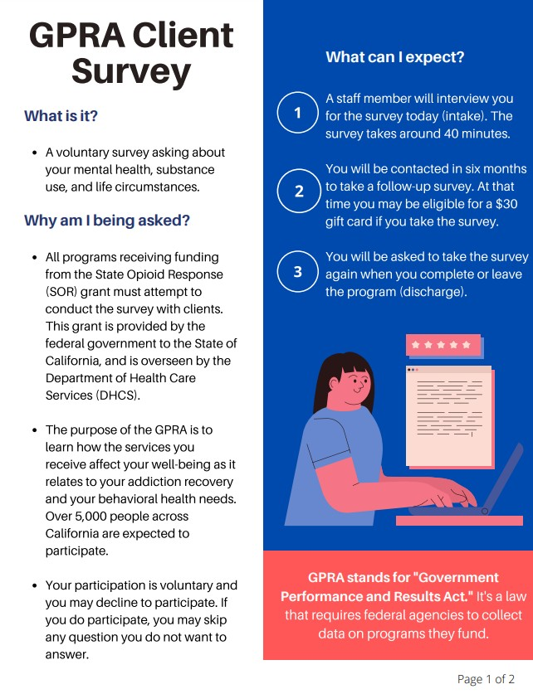
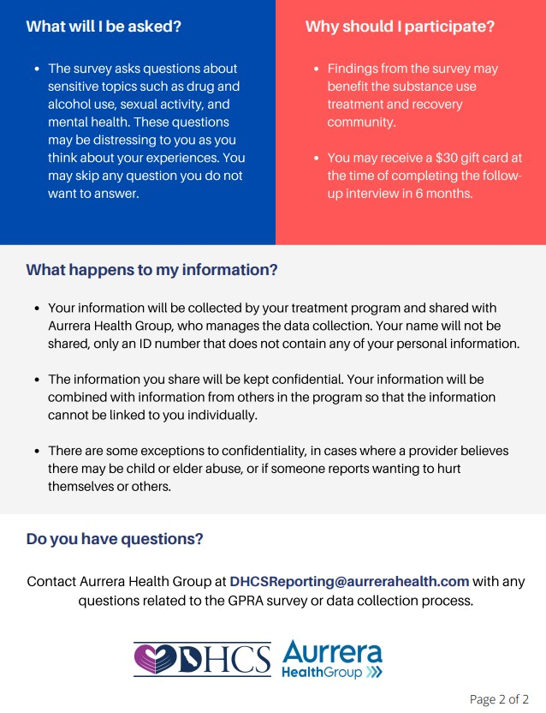
Resources
GPRA Client-Facing Flyer: English and Spanish, electronic and print- friendly versions available. You may request free printed copies from Aurrera Health Group by emailing DHCSReporting@aurrerahealth.com.

Slide 16
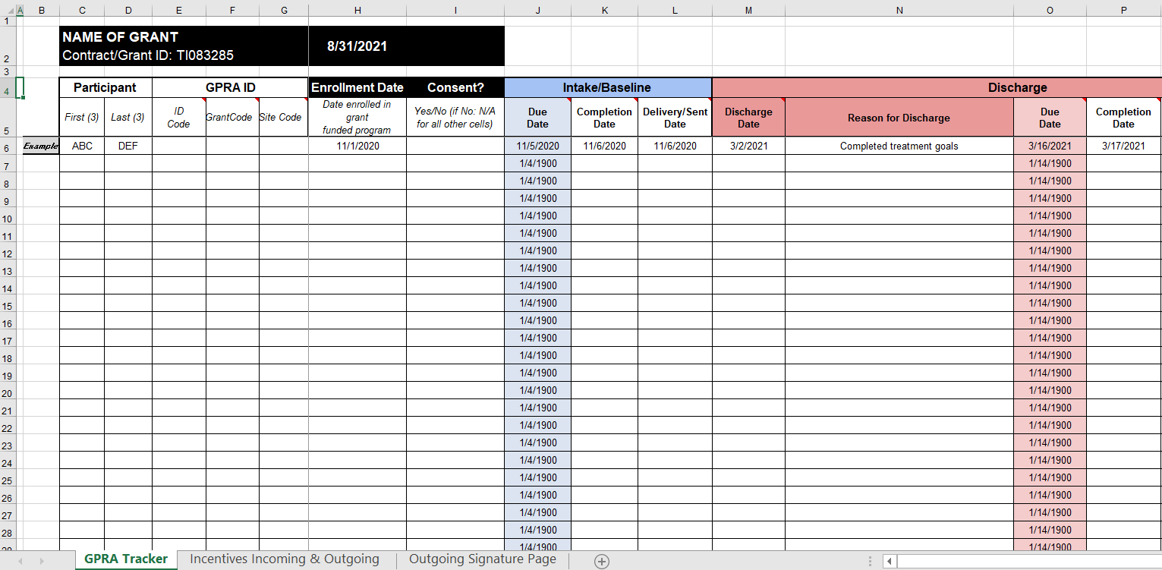
Resources
GPRA and Incentives Tracking Tool: internal tool that can be used to track survey completion and incentives.

Slide 17
Record management is filled in by Program Staff at Intake.
Section & Topic
Section A
Record Management
Demographics
Family
Military Service
Travel Time
Section B – Substance Use and Planned Services
Section C – Living Conditions
Section D – Education, Employment, and Income
These sections are self-reported by the client during the interview.

Slide 18
Self-reported by the client during the interview
Section & Topic
Section E – Legal
Section F – Mental and Physical Health Problems and Treatment/Recovery
Section G – Social Connectedness
Section H – Program Specific Questions
Section I – Follow-up Status
Section J – Discharge Status
Section K – Services Received
Section H is not required for this grant – skip this part of the survey
These sections are completed by Program Staff at follow-up, discharge

Slide 19
GPRA Survey Sections
Section & Topic | Intake | Follow-up | Discharge
Section A
Record Management
Demographics
Family
Military Service
Travel Time
Section B – Substance Use and Planned Services
Section C –Living Conditions
Section D – Education, Employment, and Income

Slide 20
GPRA Survey Sections (cont’d)
Section & Topic | Intake | Follow-up | Discharge
Section E – Legal
Section F – Mental and Physical Health Problems and Treatment/Recovery
Section G – Social Connectedness
Section H – Program Specific Questions | N/A | N/A | N/A
Section I – Follow-up Status
Section J – Discharge Status
Section K – Services Received

Slide 21
GPRA Submission

Slide 22
What is REDCap?
Research Electronic Data Capture (REDCap) is a web-based application developed by Vanderbilt University to capture data for clinical research and create databases and projects.
REDCap is HIPAA-compliant and works on any browser.
REDCap system allows Aurrera Health Group to upload data directly to SAMHSA’s SPARS portal, avoiding the need for manual entry.
To access the portal, you will need:
A reliable internet connection; and
A desktop or laptop computer or tablet.

Slide 23
GPRA Submission Process
There are two links to use for entering data:
INTAKES: Use https://redcap.link/CollectGPRAData to begin a new client intake.
DISCHARGE/FOLLOW-UP: Use your site-specific report link at the end of the GPRA handbook to access a link to discharges and follow-ups for completed client intakes.

Slide 24
GPRA Intake Tool
24

Slide 25
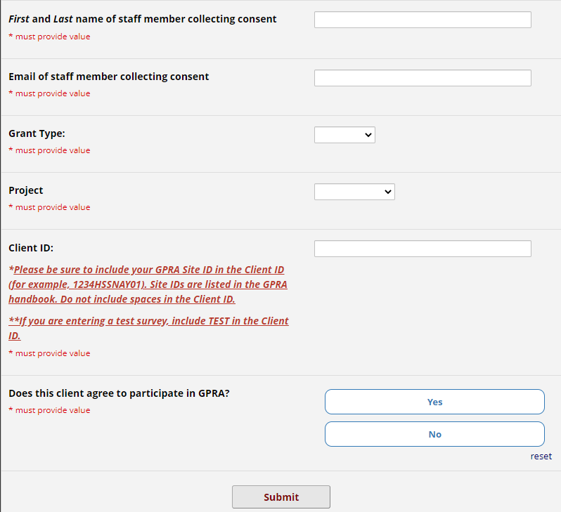
GPRA Intake
To start a new intake, go to: https://redcap.link/CollectGPRAData
2
5

Slide 26
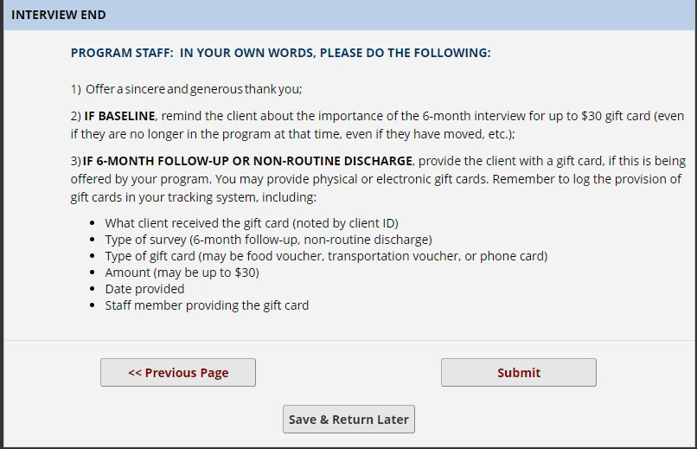
End of the Survey
The end of the survey shows a few reminders for the staff member.
To submit the survey, select “Submit.”

Slide 27
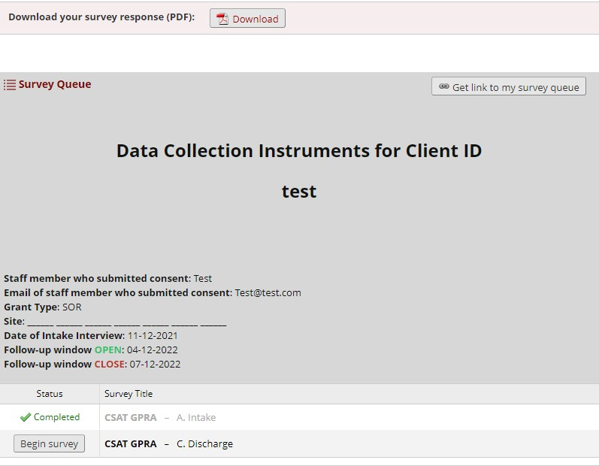
End of the Survey
There is an option to download the answers provided during the survey.
Please download the PDF and keep for your records.

Slide 28
GPRA Follow-Up and Discharge

Slide 29
Accessing the Reports Page
To enter GPRA follow-ups and discharges, you will need to access your site’s reports page. To view the reports page, click the link provided in the GPRA Handbook:
The GPRA Handbook is available on our SOR GPRA Resources page.
Go to the end of the Handbook and find the list of site IDs by project. Next to the site ID you will find a link to your site’s individual reports page.
The reports page will list all client surveys that have been entered, and provide a link to complete a follow-up or discharge.
3
6

Slide 30
Accessing the Reports Page
A link to each site’s reports page is available at the end of the GPRA Handbook, next to the site ID. This link will allow you to see surveys completed to date, access the survey queue for each client, and complete follow-ups and discharges.

Slide 31
Reports Page
The Reports Page shows all GPRA surveys that have been submitted to the system. The survey queue URL provides a link to complete a follow- up or discharge for the corresponding intake.

Slide 32
Survey Queue
To enter a discharge or follow-up, find the intake survey queue associated with that client’s intake.

Slide 33
Discharge and Follow-up
Open the survey queue link and select “Begin Survey” for the survey that needs to be completed.
*A follow up link will only become available 5 – 8 months after the intake date.

Slide 34
Tips

Slide 35
Survey Navigation
When navigating through the survey, use the “Previous Page” and “Next Page” buttons at the bottom of the page.
Refrain from using the back button on the browser.

Slide 36
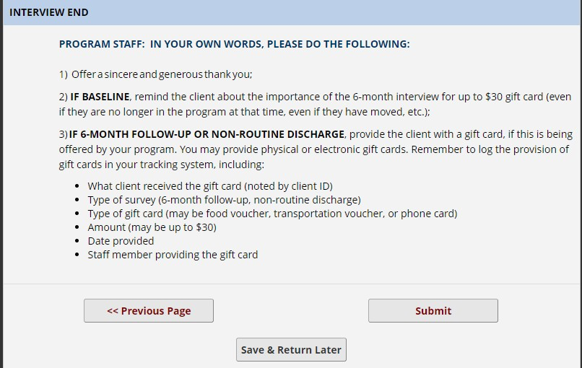
Save & Return Function
Use the “Save & Return Later” function to save the survey and come back at a later time to finish. This option is offered until the last page of the interview.

Slide 37
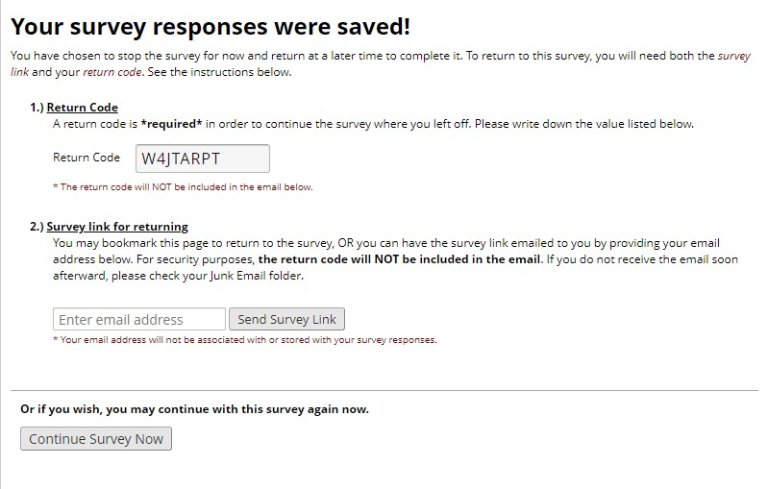
Save & Return Function
If the save and return function is selected, a return code will be provided. This is a security measure to ensure limited access to the data.
Write down the return code as it will not be available in the return link email.

Slide 38
Incorporating another completer in the submission process
The Save and Return Function can be used to allow more than one survey completer.
The first individual will need to send the survey link email to themselves. Then forward the email with the client ID and return code to the individual who will need to finish and submit the survey.
The return code will not be in the original emailed survey link!

Slide 39
GPRA Frequently Asked Questions

Slide 40
GPRA FAQs
What clients should receive GPRA?
Clients who receive treatment or recovery services for a stimulant or opioid use disorder with SOR 3 funding must complete GPRA. This includes:
Clients who are under or uninsured and who are receiving medication, counseling or other services funded by the grant.
Clients who are receive medical services from a physician, nurse, or other provider whose salary is funded by the grant.
Clients who receive counseling, peer support, or case management services from a staff member whose salary is funded by the grant.
Excluded from this are:
Clients receiving non-clinical services funded by the grant. Examples include:
Clients only engaged in prevention and education activities.
Clients whose only interaction with a grant-funded staff member is with administrative/front desk support staff.
Clients who are receiving screening or referral services, who have not yet been admitted for substance use treatment or recovery services.

Slide 41
GPRA FAQs
Can the surveys be completed by phone?
During the COVID-19 Public Health Emergency, surveys may be completed by telehealth, including telephone. You will be notified if guidance changes with the Public Health Emergency ends.
What if a patient is covered by Medi-Cal? Do they need a GPRA?
If a patient is covered by Medi-Cal but receiving services from a provider funded by SOR funds, they would still need to complete GPRA.
What should we submit for clients who decline?
Indicate the client’s yes/no consent response on the start form of the intake survey. If the client declines, the survey will end.

Slide 42
GPRA FAQs
Should we assign a client ID even if the client declines the survey?
Yes, assign all eligible clients a client ID even if they decline the survey, to assist with tracking.
Do clients who decline the intake need to complete the other surveys?
Clients who decline the survey will be listed in the Reports page. A follow-up and discharge will not need to be completed for clients who decline the intake.
Do we need to use the consent form for each interview (intake, follow-up and discharge)?
The consent form is only needed before the intake. However, clients may decline subsequent interviews even if they agree to the intake.

Slide 43
GPRA FAQs
What if it wasn't possible to administer GPRA during the Intake process and the client doesn't come back?
In this case, you do not need to submit GPRA. If the client comes back to treatment, do an intake when they re-enter the program.
If we cannot reach a client for their six-month follow-up or discharge, how should we document this client?
If you cannot contact the client after 14 days of trying, complete an administrative follow-up or discharge. Access the survey queue link for the client from your site’s report page and select follow-up or discharge depending on the survey; when asked “Did you conduct a follow- up/discharge interview,” select “No” to proceed to the administrative follow-up/discharge.

Slide 44
GPRA FAQs
When should we conduct the discharge survey?
If your program has an existing discharge definition or policy, follow that discharge definition or policy, and conduct the discharge survey at that time. If you do not have a discharge definition or policy, complete a discharge interview for all clients for whom 30 days have elapsed from the time you last had contact with the client.
What if clients leave and then return to treatment?
Conduct the discharge survey when the client leaves treatment. If the client comes back after being discharged, a new intake should be completed, with the same client ID to note that this is the same client.

Slide 45
GPRA FAQs
How do I change or edit a survey submitted through REDCap?
Surveys cannot be edited after they are submitted. If you need to make a change to a survey after you have already submitted it, reach out to Aurrera and we will make the change.
Can I access past submitted surveys from my site’s reports page?
Surveys cannot be accessed from the reports page. If you need access to a survey you have submitted, reach out to Aurrera and we will provide you the survey.
I lost the return code to return to a survey I saved. How do I get it back?
Email Aurrera Health Group at DHCSReporting@aurrerahealth.com and we will provide you the return code needed.

Slide 46
GPRA FAQs
Our site is new to SOR funding and GPRA requirements, where do we find our program specific page for REDCap?
Aurrera is in the process of creating new site pages in REDCap and will update the Handbook with new site IDs and report pages soon.
Our site branched into new sites in SOR 3 – how do we track clients who had previously been under the main site ID moving to new site IDs?
Please email DHCSReporting@aurrerahealth.com for personalized assistance. We will ask for a list of client IDs that need to be migrated to a new site report page, but the client themselves aren’t changing location.
How do we handle clients that are moving from one site to another?
For clients who are moving physical locations, complete a discharge survey at their current site. When they present at the new site, complete an intake and assign a new client ID. This is to maintain consistency with clients who change sites without site collaboration.

Slide 47
GPRA FAQs
Can I provide an incentive for clients to take the survey?
For certain types of interviews, you can use SOR funding to pay for incentives, with a maximum cash value of $30 per interview. The incentives can include items such as food vouchers, transportation vouchers, or phone cards.
Incentives are not permitted for:
X GPRA intake interviews.
X Routine GPRA discharge interviews
Incentives are permitted for:
Completion of a six-month follow-up interview.
Discharge interviews where program staff must search for a client who has left the program or a client who has dropped out of a program.

Slide 48
GPRA FAQs
How does the GPRA incentive relate to incentives used in our Contingency Management program?
GPRA incentives are intended to improve rates of follow-up and discharge completion; they are separate from incentives provided for Contingency Management, which are provided as part of a treatment approach.
Does the $30 GPRA incentive count toward the $75 per year limit on incentives for Medicaid beneficiaries?
SAMHSA has clarified that the $30 GPRA incentive is separate from the $75 annual limit on incentives for contingency management.

Slide 49
GPRA FAQs
What should I track if I plan to provide GPRA incentives?
Sites should implement a system to track gift cards provided to individuals for completing six-month follow-up and discharge surveys where the client is hard to contact. Sites should develop a log system that tracks:
What client received the gift card (noted by client ID)
Type of survey (six-month follow-up, non-routine discharge)
Type of gift card (may be food voucher, transportation voucher, or phone card)
Amount (may be up to $30)
Date provided
Staff member providing the gift card

Slide 50
Questions?
DHCSReporting@aurrerahealth.com – inbox monitored for sites to request assistance.

